Slide 1
Dan Birman
2016-02-16
Frisem

Slide 2
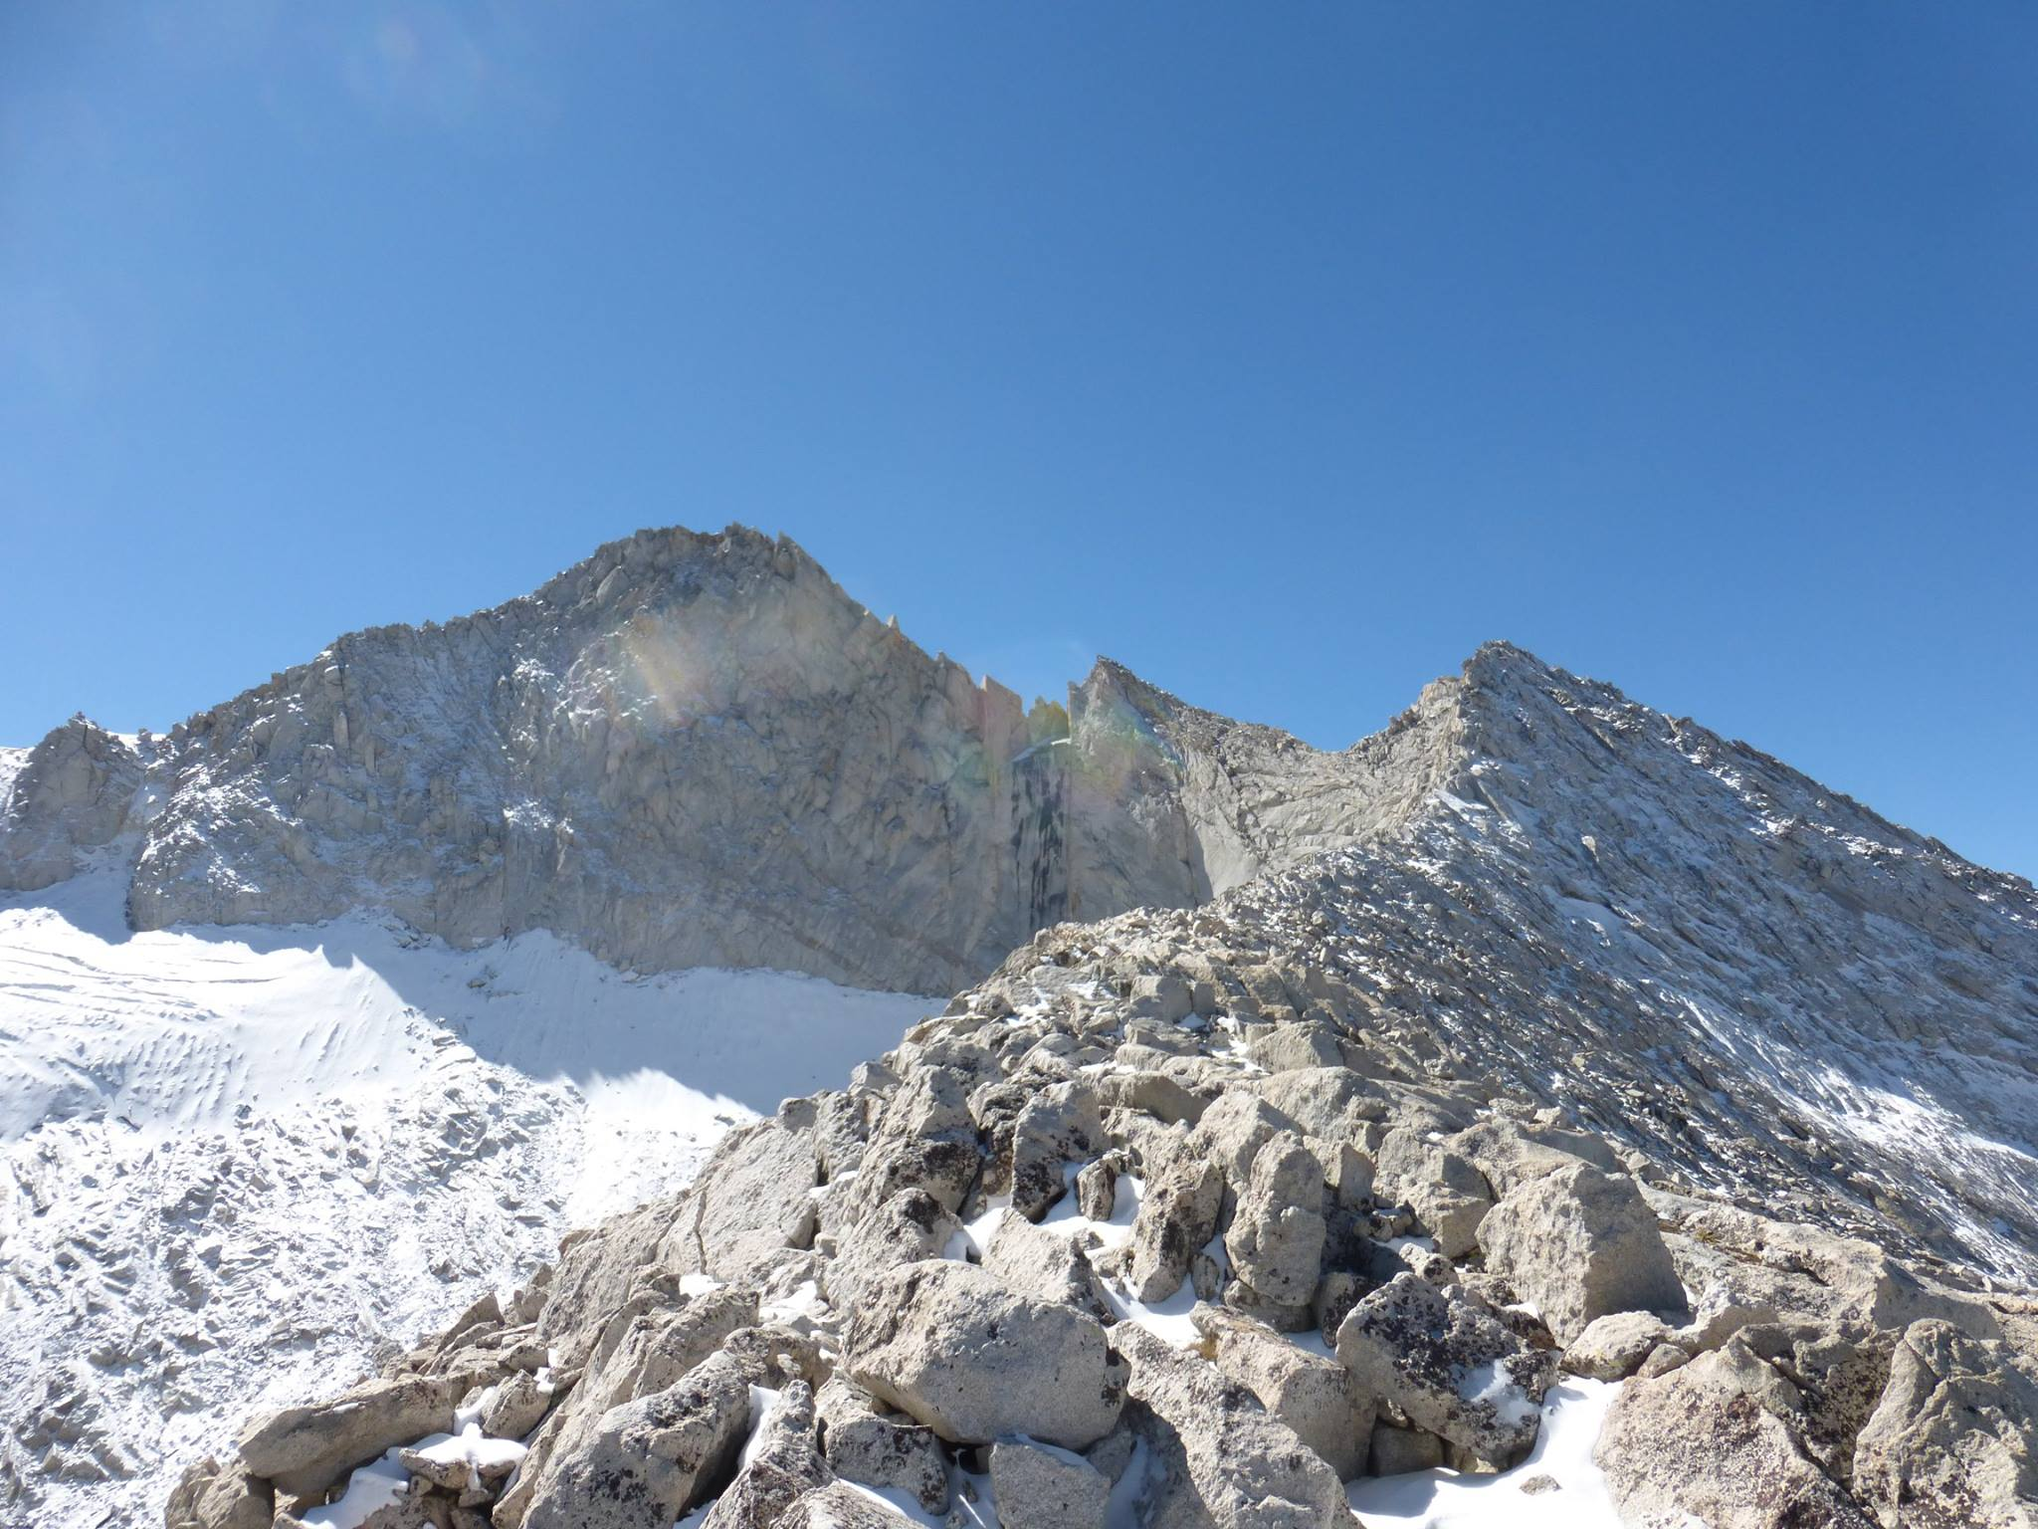

Slide 3
Add pictures of 5.15 game… for fun!
#five15game

Slide 4
Dan Birman
2016-02-16
Frisem

Slide 5
Using monkeys as models for humans…
Dan Birman
2016-02-16
Frisem

Slide 6
Using monkeys as models for humans…
And when that breaks down, using
humans as models for the monkeys…
Dan Birman
2016-02-16
Frisem

Slide 7
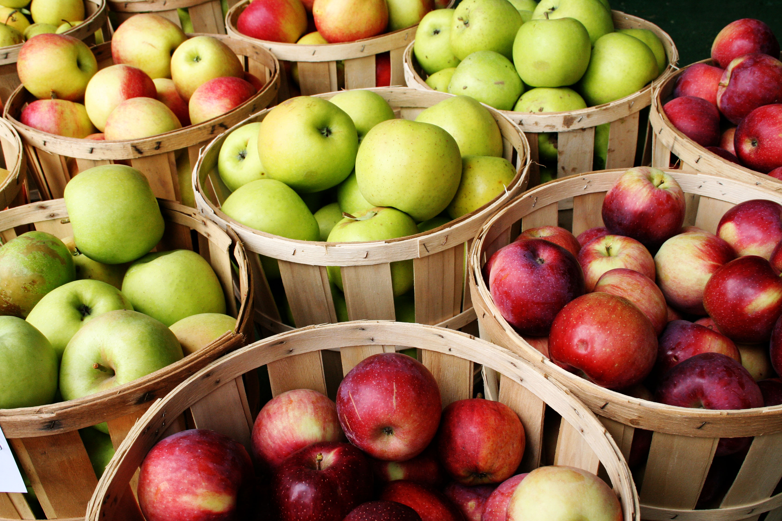

Slide 8
Color
Taste
Size

Slide 9
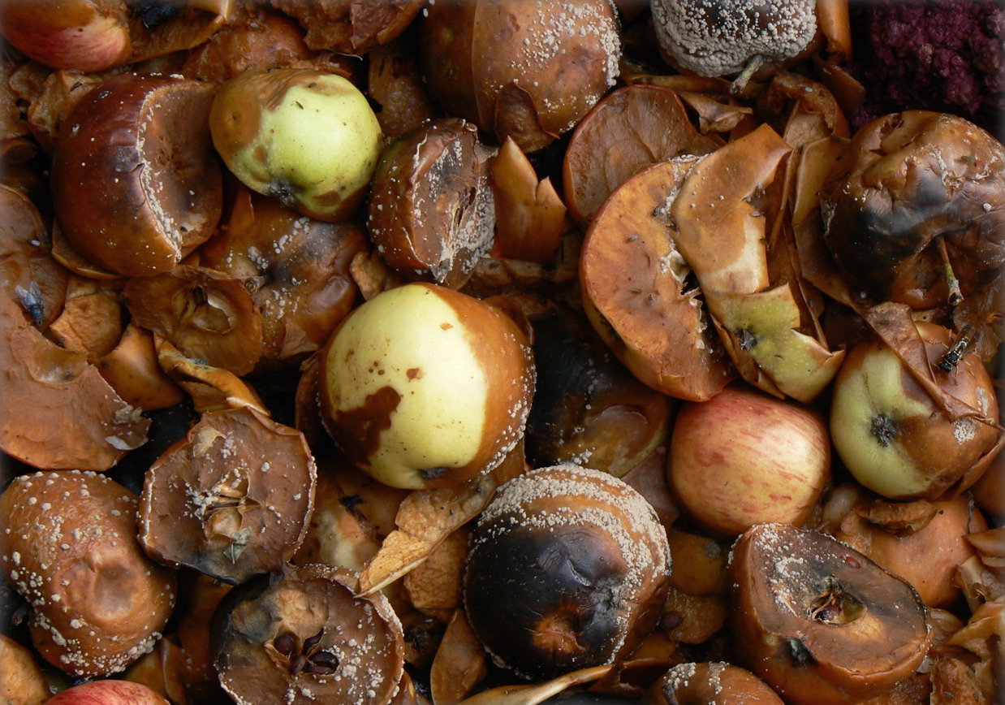
Rotten
Color
Healthy
Taste
Size

Slide 10
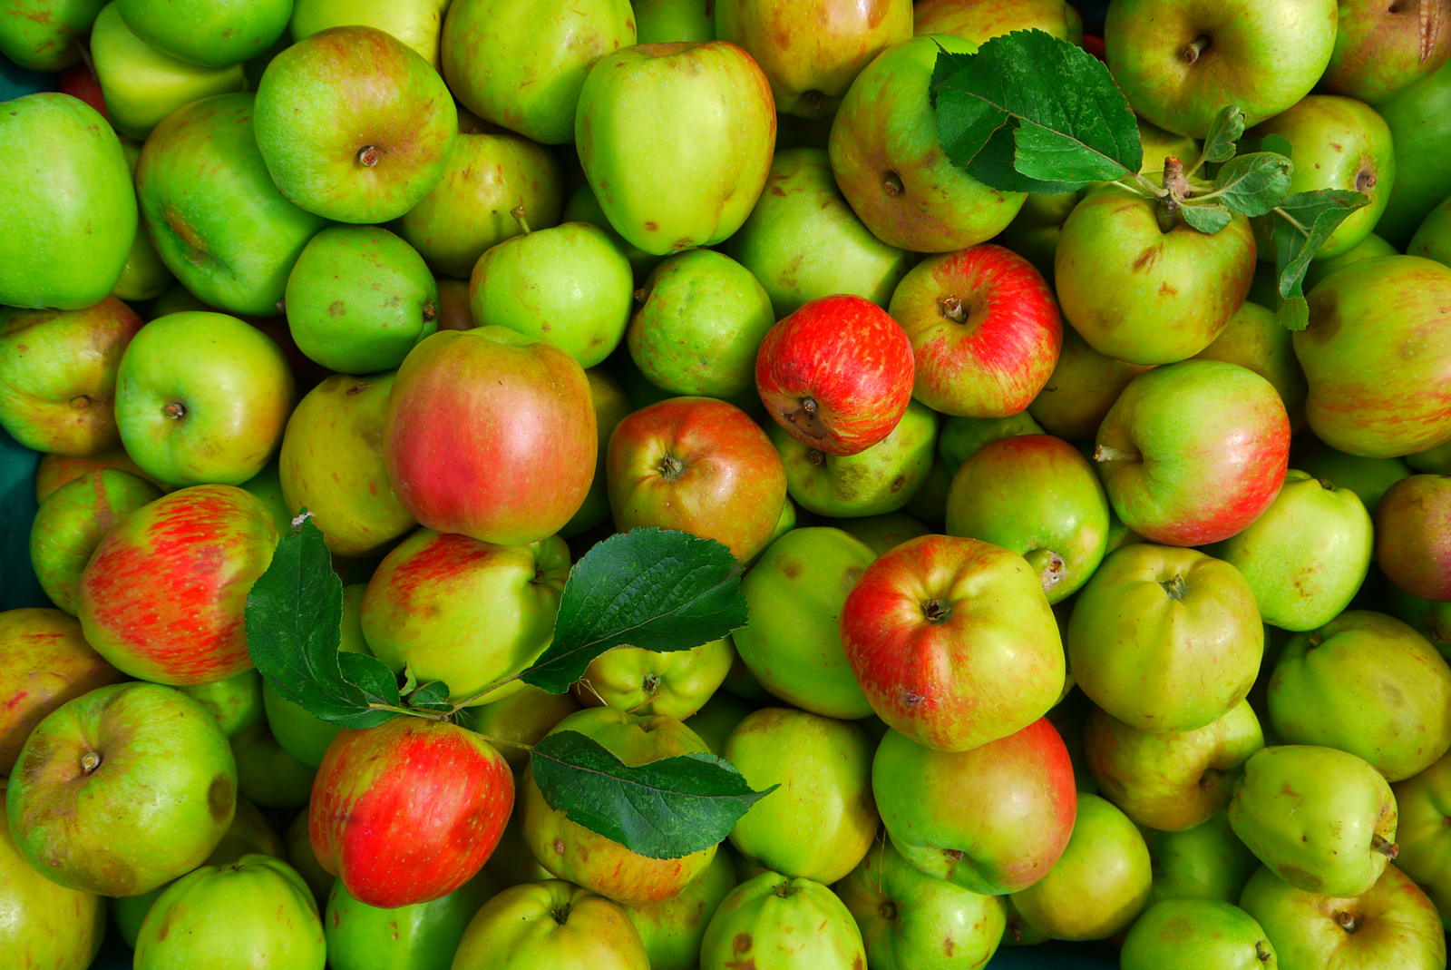
Notes:
Operationalized version of task!!

Slide 11
Freedman, D.J. & Assad, J.A. Nature 443, 85–88 (2006).
Sarma, A., Masse, N.Y., Wang, X.-J. & Freedman, D.J. Nat. Neurosci. 19, 143–149 (2016).
Categorization in monkeys
Be clear: the monkeys are doing categorization TASKS!

Slide 12
Operationalizing Categorization
What is it like to be a monkey doing categorization?
Rotten
Color
Healthy
Taste
Size

Slide 13
Demo Time!
Implicit learning tasks
Two stimuli: learn the rule!
Press – or don’t press

Slide 14
Demo Time!
stanford.io/24mI6IV
stanford.io/1QytfqA

Slide 15
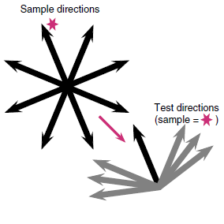
No rule given Learning!

Slide 16
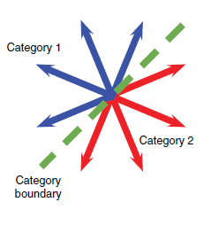

Slide 17
Humans

Slide 18
Humans
Very Easy

Slide 19
Humans
Very Easy
Hard

Slide 20
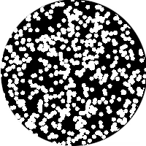

Slide 32
Mostly pick
“same”

Slide 33
Mostly pick
“different”
Mostly pick
“same”

Slide 34
50/50
Mostly pick
“different”
Mostly pick
“same”

Slide 35
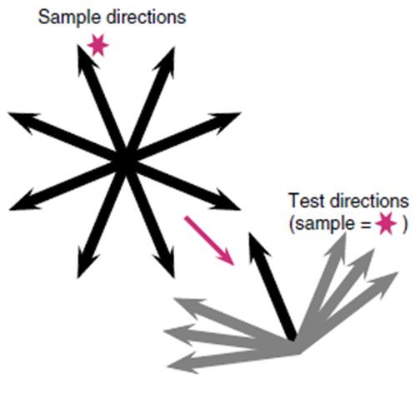
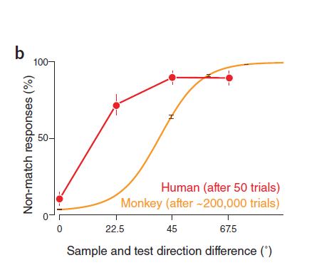

Slide 37
% of “Different” Choices

Slide 38
% of “Different” Choices

Slide 39
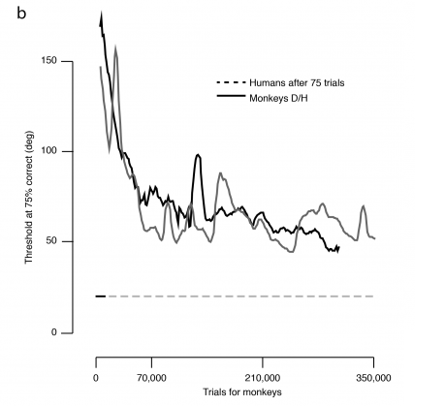
Human Performance (75 trials)

Slide 40
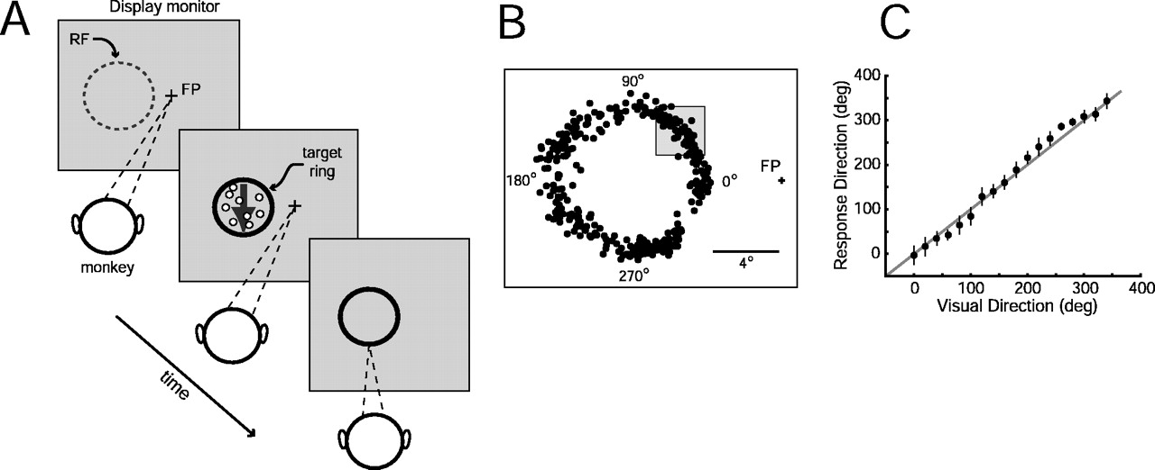
M. James Nichols, and William T. Newsome J. Neurosci. 2002;22:9530-9540

Slide 41
Humans
Monkeys
Very
Difficult
Very Easy
Hard

Slide 42
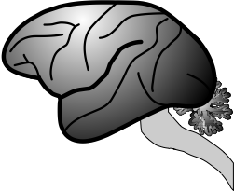

Slide 43
Did we operationalize categorization correctly?

Slide 44
What is it like to be a monkey?
Did we operationalize categorization correctly?

Slide 45
Slide about differences between tasks?
Both tasks are about abstract categories, but # of categories is different, and range of features
In the categories is different, hard to infer from behavior what they are doing
It’s not that one task is more difficult than another it’s that we test the wrong hypotheses, are the monkeys doing the same thing/

Slide 46
Pointing out that inferring difficulty from your speed of learning is backwards?
Are monkeys really doing something completely different? Or are they not set up to learn this kind of abstract hypothesis
Slide about differences between tasks?
Both tasks are about abstract categories, but # of categories is different, and range of features
In the categories is different, hard to infer from behavior what they are doing

Slide 47
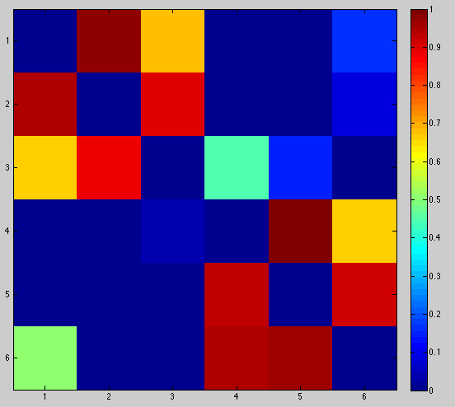

Slide 48
Humans
Monkeys
Very
Difficult
Very Easy
Hard, but
doable
Hard

Slide 49
Humans
Monkeys
Very
Difficult
Very Easy
~10 Trials
~100,000 Trials
Hard, but
doable
Hard
~1,000 Trials
~10,000 Trials

Slide 50
What is it like to be a monkey?

Slide 51
What is it like to be a monkey?
What (human) brain areas compute categories, and what algorithms do they use?

Slide 52
What is it like to be a monkey?
What features do we think are important?
Humans bring very different things to the table compared to monkeys
It could be the simplest rule –you won’t know
At a minimum we should ask the question, but it isn’t clear what the explanation is or what it means for neurophysiology
What (human) brain areas compute categories, and what algorithms do they use?

Slide 53
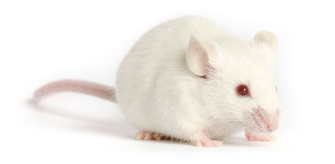

Slide 54
Operationalizing
Cognition

Slide 55
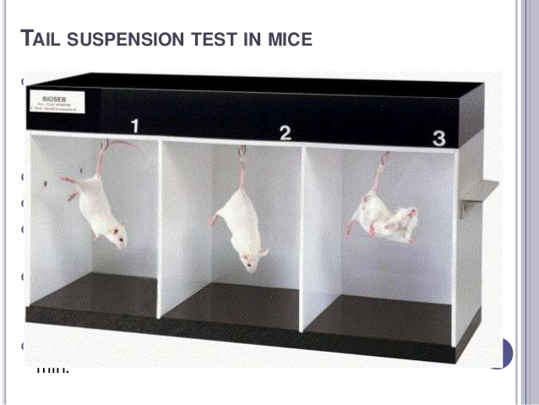
Similar issues with humans
Operationalizing tasks and making
Sure that the cognitive task is actually correct
Operationalizing
Cognition

Slide 56




Thank you!
Justin Gardner
Freedman Lab @ U Chicago
Nick Masse
David Freedman

